Slide 1
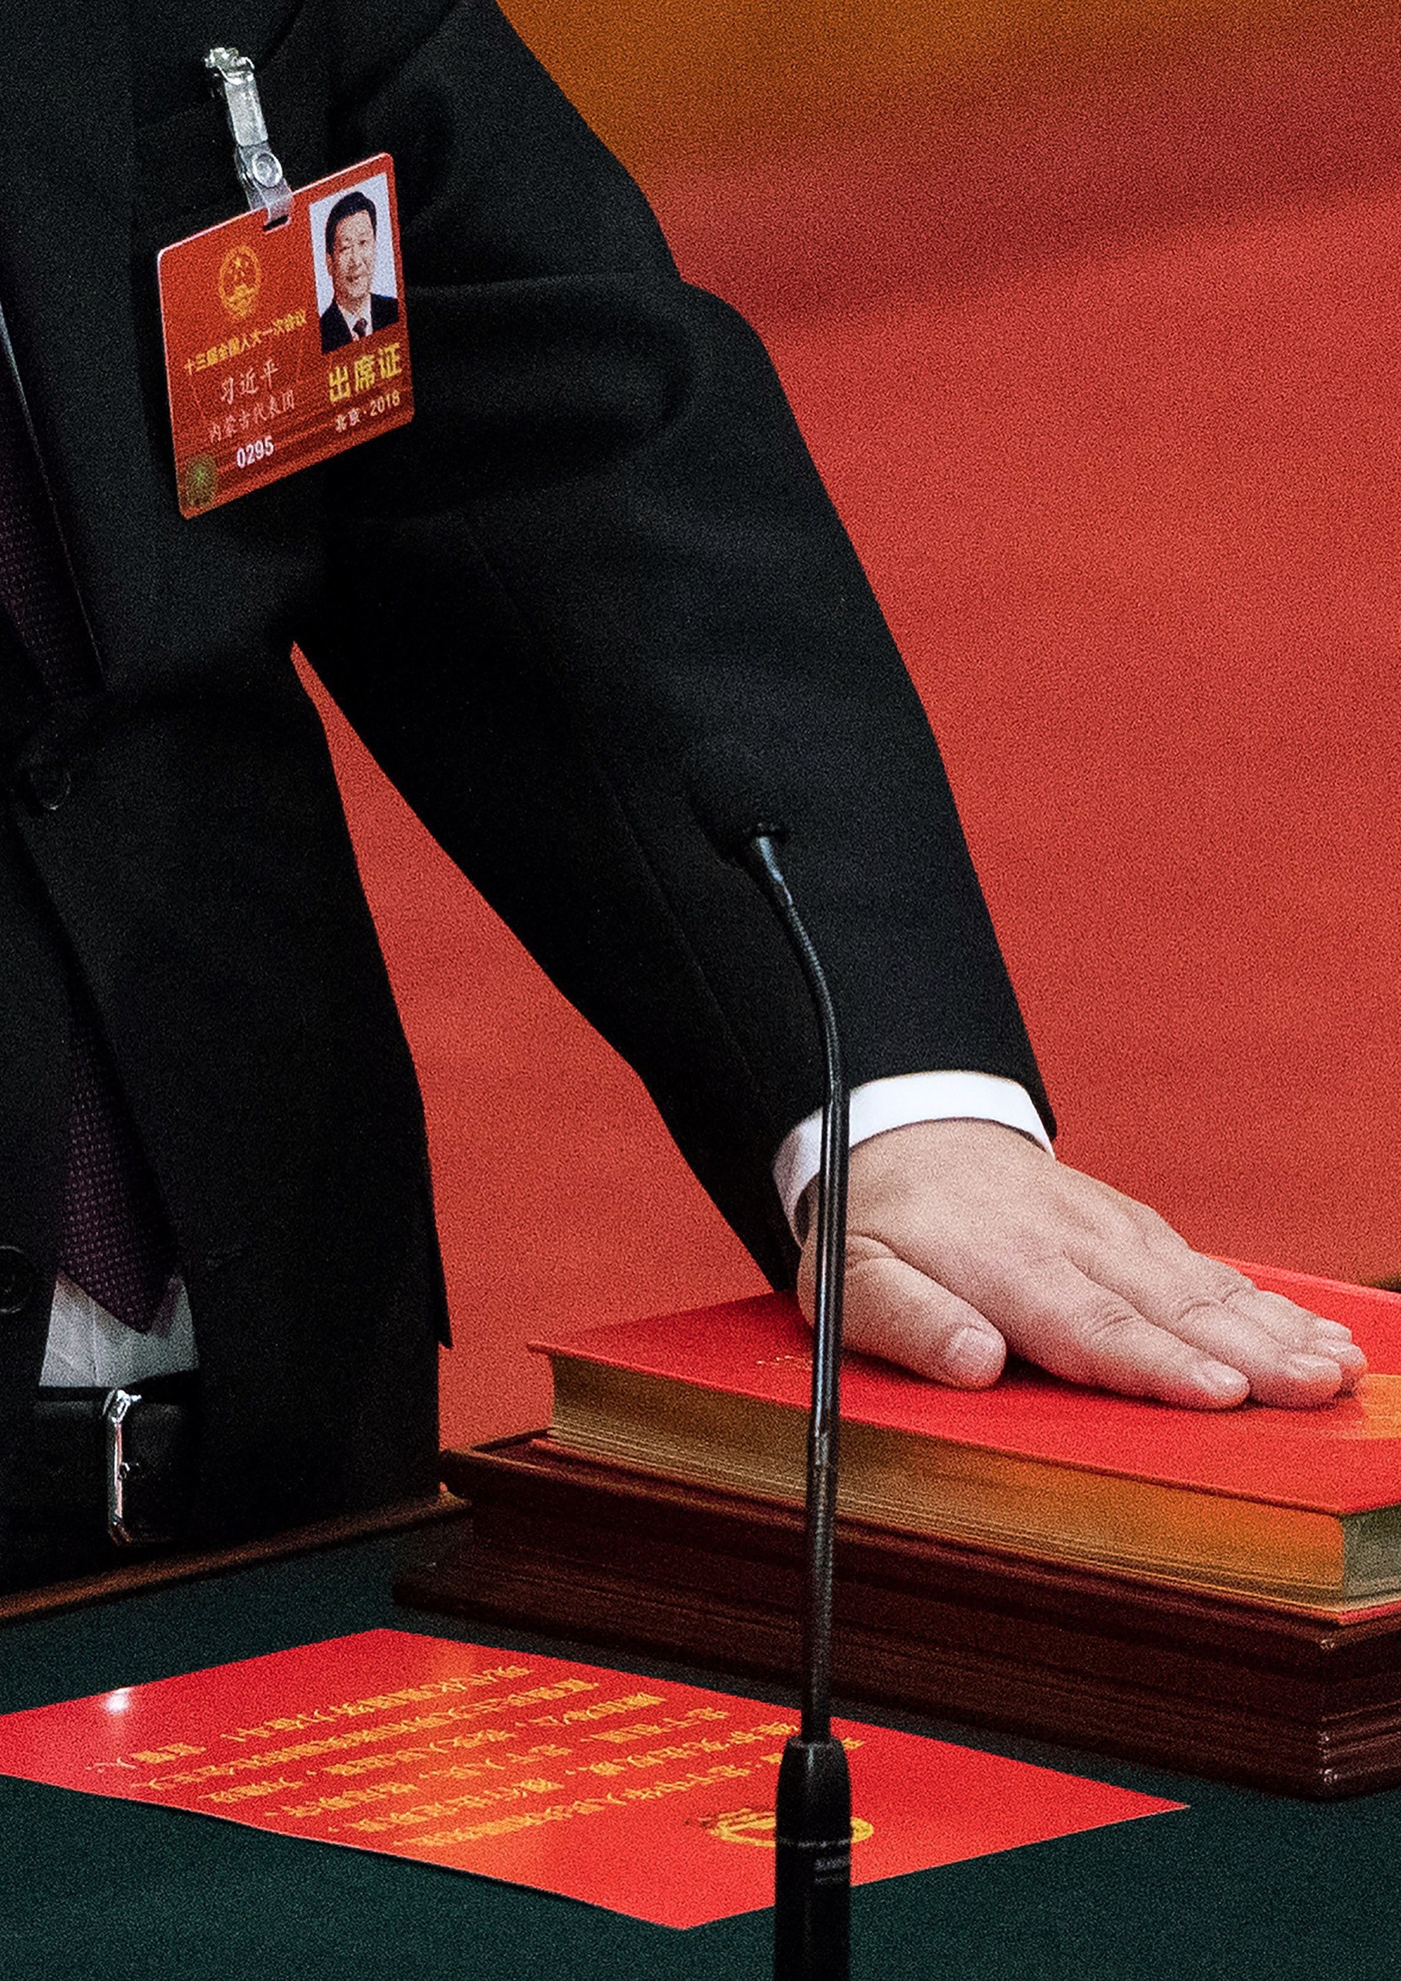
2018 Two Sessions: The Future of China
A review of China’s latest political gathering and what it means for businesses engaging with China
March 2018

Slide 2
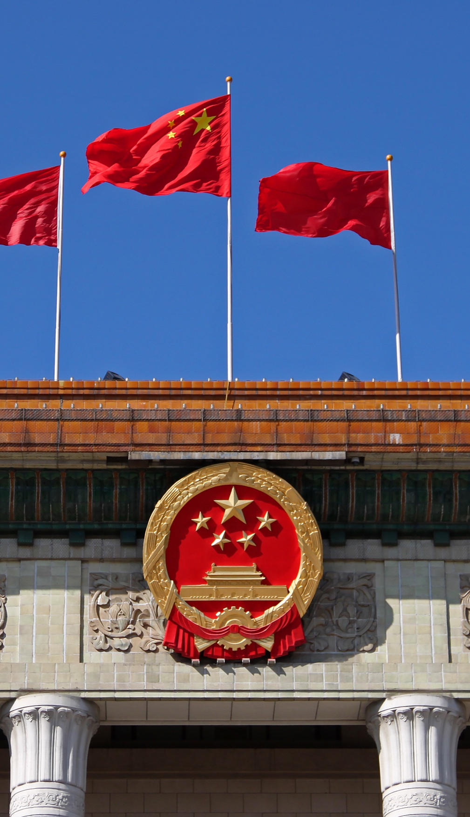
Defining China’s Future
The Next Five Years and Beyond
    The significance of this year’s lianghui will have a profound impact on both China’s future and the world’s engagement with China. The changes to China’s constitution and governance structures are arguably the most significant since the reform era began 40 years ago and certainly since Deng Xiaoping’s Southern Tour in the spring of 1992.
    The lianghui, or “Two Sessions”, refers to the annual two-week long meetings, held at the start of March, of the National People’s Congress (“NPC”) and the Chinese People’s Political Consultative Conference (“CPPCC”).
    Attention has focused on the removal of presidential term limits from the constitution, leaving the door open for Xi Jinping to lead the country indefinitely. There is little doubt that Xi will be in office for at least a third term and likely far beyond.
    But to focus on Xi’s consolidation of his position at the center of the Party arguably misses the real significance of this year’s lianghui. Indeed, the removal of the term limit brings the presidential title in line with the head of the Party, which is the most important position Xi holds and which has never had a term limit.
    Instead, this is a moment historians are likely to look back on as the point China laid the foundations for successful economic reforms that will drive the next phase of China’s development, or when it made one last attempt to force them through.
    There is plenty to analyze, not least the single biggest reorganization of the government structure since the reform era began 40 years ago. We look at many of the key known changes later in this report.
    There are of course long-term concerns around a lack of presidential term limits—from succession planning to checks and balances. Discussion on these risks is well underway. Instead of adding to that debate, we have focused our review on the implications of this year’s lianghui for business.
    Ultimately, the business environment depends on Xi’s ability to reform the economy and tackle a range of structural challenges.

Slide 3
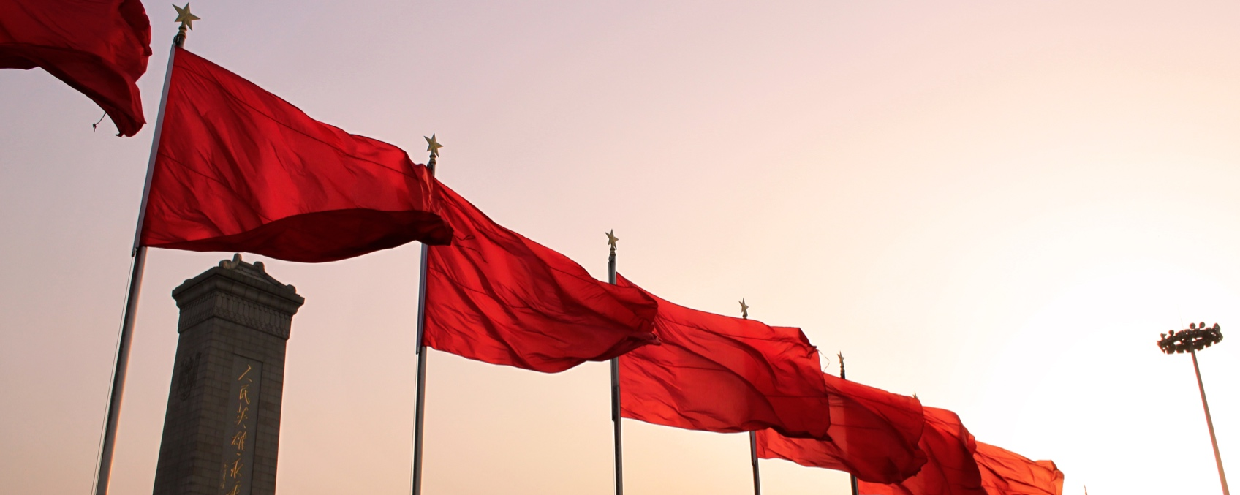
    Much will depend on how things shape out in the coming year to eighteen months but for now, a few things seem clear:
      The Party is at the center. If there was any question remaining, this lianghui has made it crystal clear that Xi is unequivocally above any other person in the country. Challenge Xi, challenge the authority of the Party. Challenge the Party, challenge the foundation of the nation.
      The line between Party and state blur further. This latest restructuring has further blurred the distinction between the Party and the government with the former exercising more official control over the running of the country—there can be no doubt as to the Party’s role in the nation’s future.
      Allegiance to the constitution. At this year’s lianghui officials placed their left hand on the constitution and raised their right hand in a fist as they swore allegiance and commitment to uphold the constitution. This is the first time officials have sworn allegiance to an entity other than the Party. The images were striking. The oath may elevate the role of the constitution, but leaves more questions about the relationship between Party and constitution.
      Committed to the Chinese Dream. Xi remains committed to the ‘Chinese Dream’—a somewhat ill-defined rejuvenation of the Chinese nation that sees the country standing tall on the world stage. This vision and dream will continue to drive the next five years. At a practical level, Xi will focus on triumphing in the three “critical battles” he outlined last October—severe poverty, environmental pollution, and financial risk.
      Expect bolder reforms. Initiatives taken in the first five-year term will continue (e.g. fighting corruption and expanding the Party’s role in the country), but expect Xi to leverage his consolidated power and the new streamlined government structure to push through a bolder reform agenda. Do not expect Western political reform or any reform that undermines the Party’s position.
      Market access on China’s terms. Premier Li Keqiang noted that China still has much room for further opening-up but voiced continued commitment. At the end of the lianghui he surprised the drug sector by committing to “slash” tariffs and stating that compulsory technology transfers will be eliminated on foreign investment in the general manufacturing sector. However, sectors deemed vital to national security (energy, technology) will remain closely guarded and present market access challenges. Pushing for reciprocity remains critical.
      Expect decisive action. With power consolidated and the system streamlined, expect officials to move decisively to achieve goals. At the same time, there will be little flexibility in the interpretation of rules that are designed to win the three battles against severe poverty, pollution and financial risk.
      Expect a more assertive presence on the global stage. Expect China to continue to increase its assertiveness as the global diplomat and to adopt an ever more assertive foreign policy agenda. In a highly patriotic speech at the end of the lianghui, Xi promised that China will “ride the mighty east wind of the new era.” Xi’s position on the global stage is all the more apparent when compared to the instability and unpredictability in multiple corners of the world.
      It’s all about efficiency and effectiveness. The structural changes to regulatory bodies are designed to tackle bureaucratic inefficiencies, address overlapping responsibilities, and achieve greater agency focus. This is undoubtedly a good thing for business and for the people.
    At a practical level:
      The restructuring is significant—it will take time for the dust to settle. The restructuring will take time to execute as new agencies are established, functions transferred, and officials move agency or role. Government decision-making will be impacted over the next few months. Plan accordingly.
      Businesses need to take a fresh look at China. The extent of changes this week are far reaching and mean that most companies will find government stakeholders will have changed. It’s vital to take a fresh look at the stakeholder environment – from the agencies to the individual officials – and their new remits and responsibilities.
      Policy, not politics. Just as businesses must engage with the EU without becoming fixated on the political eccentricities of the bloc, China requires a focus on policy over politics. What matters is not that Xi Jinping is in place for the foreseeable future; that’s now a given. It is where businesses fit in with this government’s agenda. Robust corporate environmental policies, commitments to data protection and a clear China value proposition are vital.

Slide 4
A New Government Unveiled
  Since 1978, China has adjusted the structure of its government almost every five years. Since the early 1990s, key restructurings have traditionally been made during the First Session of each five-year NPC administration when a new generation of leaders takes office (e.g. 1993. 2003, and 2013) with more substantial changes implemented at the first session of the following five-year NPC administration (e.g. 1998, 2008, and now 2018), which has until now been effectively the mid-term.
  The changes announced this session rival those in 1998 and are arguably the most substantive single set of changes since the reform era began 40 years ago. The total number of government ministries and commissions remains largely unchanged (growing from 25 to 26), yet this obscures the real significance.
  The restructuring has been driven by a bid to cut bureaucracy and remove overlap in responsibilities. The changes range from the establishment of new agencies to the consolidation of agencies and retooling existing agencies’ focus and authority.
  Ministerial level entities will be reduced by eight and vice-ministerial ranked entities will fall by seven. Eight entirely new agencies will be created. Eight will cease to exist with responsibilities folded into existing or new agencies. Three will be reorganized to have new responsibilities added.
  The previous structure saw many sectors regulated by competing agencies. Turf wars were frequent. This not only presented challenges for companies caught between competing agencies, but also meant issues fell between the cracks and exposed the nation to risks. For example, no single authority had end-to-end oversight over food safety from seed to table.
  In the sections that follow we look at some key sectors and the agencies that will be responsible for them.
The New Ministerial Structure
    Below is the new ministerial structure—26 ministries with eight brand new agencies. There are few—if any—that have not had responsibilities adjusted.
Ministry of Foreign Affairs
Ministry of National Defence
National Development and Reform Commission
Ministry of Education
Ministry of Science and Technology
Ministry of Industry and Information Technology
State Ethnic Affairs Commission
Ministry of Public Security
Ministry of
State Security
Ministry of
Civil Affairs
Ministry of Justice
Ministry of Finance
Ministry of Human
Resources and Social Security
Ministry of Natural Resources
Ministry of Ecological Environment
Ministry of Housing and Urban-Rural Development
Ministry of Transport
Ministry of Water Resources
Ministry of Agriculture and Rural Affairs
Ministry of Commerce
Ministry of Culture and Tourism
National Health Commission
Ministry of Veterans Affairs
Ministry of Emergency Management
People's Bank
of China
National Audit Office
Newly Established Ministry

Slide 5
Change in Scale of Government Structure Through the Reform Era
* At the time of writing, the departments, offices and special departments directly under the State Council have not been confirmed
Anti-Corruption
    Soon after taking office five years ago, Xi Jinping launched an anti-corruption campaign like none that had gone before it in China. He is not the first leader to tackle corruption. But, in the past these were genuine campaigns. There was an end. Frequently they were short lived and soon corrupt practices resumed.
    During this year’s meeting China’s leaders approved changes to the constitution and approved the National Supervision Law that locks in place a new system to oversee anti-corruption across the Party and state system.
    Previously, supervisory powers were split across three branches of the system. Party agencies were responsible for Party members, administrative agencies for officials and civil servants, and the procuratorates for state functions.
    The newly established National Supervisory Commission consolidates the anti-graft investigation responsibilities of the Central Commission for Discipline Inspection (under the Party) with a number of related organizations across the government—including the Ministry of Supervision, the National Bureau of Corruption Prevention, and anti-corruption functions from law enforcement and the procuratorates.
    The commission has the same administrative ranking as the State Council and reports directly into the National People’s Congress (as does the State Council). To maintain impartiality and to break local cliques, investigations are carried out by those of equal or higher rank than those being investigated. At the local level, investigations will be led by a team one jurisdictional level higher.
    Implication: Xi’s anti-corruption drive ceased being a campaign long ago. It has been too far reaching in terms of time, geography, and scale. It is a new way of life. There can be no question about the commitment to eradicating corruption.
    This provides the new commission with jurisdiction across all Party members as well as government officials, state-owned enterprise employees and those working in any state institution (e.g. schools, research institutes, etc). The jurisdictional reach further blurs the line between Party and state.

Slide 6
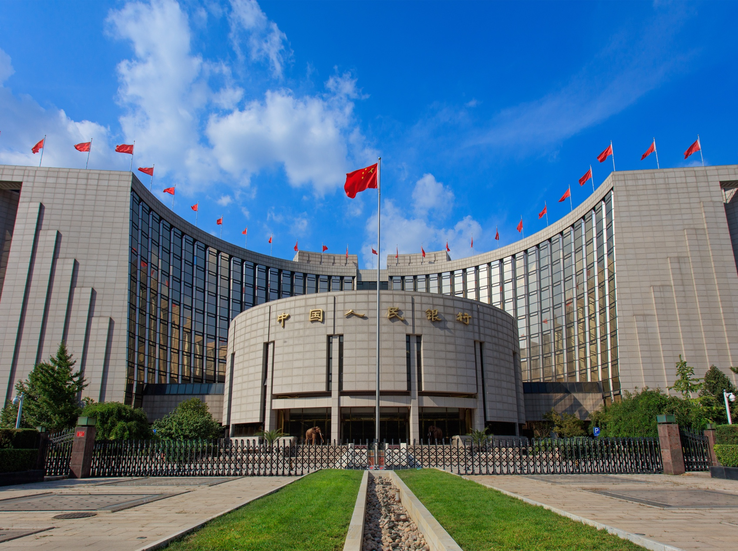
Banking & Finance
    In recent years, banking and finance have become a classic case of a sector outgrowing its regulatory framework. The separate bodies that oversaw banking, insurance and securities—the China Banking Regulatory Commission (“CBRC”), the China Insurance Regulatory Commission (“CIRC””) and the China Securities Regulatory Commission (“CSRC”), respectively—have increasingly overlapped as the markets have become more sophisticated. This has led to missteps, loopholes and finger-pointing that the central leadership was determined to address. And at first glance, it appears they could well be successful.
    The CBRC and the CIRC, whose head was put under investigation last spring for “serious disciplinary violations,” will be merged into the China Banking and Insurance Regulatory Commission (中国银行保险监督管理委员会) (“CBIRC”). This new consolidated entity will be headed by erstwhile CBRC head, the widely-respected Guo Shuqing. The CSRC will remain separate, retaining most of its previous brief.
    Meanwhile, the People’s Bank of China sees its role change significantly. China’s central bank is now responsible not only for monetary policy and overall regulation of the sector, but also policymaking, effectively relegating the CBIRC and CSRC to an implementation role. The PBOC’s new governor Yi Gang’s extensive experience in both monetary and foreign exchange policy makes him the ideal candidate to succeed the universally respected Zhou Xiaochuan, who retires.
    Mr. Yi will report directly to Liu He, the new vice-premier and close ally of Xi Jinping who will effectively coordinate economic policy on Mr. Xi’s behalf – reducing further the influence of Premier Li Keqiang. Liu and Yi’s strong relationship may prove pivotal to the success of this new arrangement. The Ministry of Finance will remain important under the competent but politically low-key Liu Kun, but the signs are clear:
    Implications: For business (Chinese and foreign, alike) these changes are good news. We’re likely to see more coordinated policymaking and regulation, as China seeks to rein in irresponsible lending, increase transparency and corporate governance, and bring its banking and insurance sectors further into line with their counterparts in developed countries (with the inevitable caveat that they are subject to Communist Party control).
    Not only that, but this is all happening just as China opens its financial markets to greater foreign participation. Following the surprise news late last year that China was lifting restrictions on foreign ownership of financial firms, this week Liu He set a one-year time frame for greater foreign participation in the sector, and the government announced foreign payments firms would be allowed to join China’s booming market. Finance is arguably the bright spot for foreign market access.

Slide 7

The Environment
  Ministry of Ecological Environment
    This new ministry replaces the Ministry of Environmental Protection (MEP) and assumes responsibilities previously held by the Ministry of Land and Resources, State Oceanic Administration, National Development and Reform Commission, Ministry of Agriculture, and the Ministry of Water Resources.
    The Ministry of Ecological Environment (生态环境部) will be responsible for tackling environmental issues spanning air, rivers, lakes, the ocean, soil, underground water, and agricultural pollution. It will also be responsible for addressing climate change and emissions controls.
    Implication: The establishment of the Ministry of Ecological Environment (“MEE”) has the potential to be a game changer in China’s commitment to tackling environmental degradation. While Party Secretary of Zhejiang, President Xi noted “we would rather have green mountains and blue water than gold or silver mountains”.
    During enhanced environmental inspections last year, many companies were forced to close factories or relocate due to stronger enforcement and non-compliance with the latest environmental regulations. Many cases focused on air pollution and waste water treatment non-compliance, but expect over the years ahead all aspects of environmental considerations to be reviewed—from air and water to soil and heavy metals. The new ministry intends to set up a new nationwide inspection system to increase the rate of environmental checks.
    Businesses must stay abreast of new environmental policies, ensure compliance, prepare for increased checks, and expect little flexibility in interpretation of environmental compliance.
    The dramatic improvement of air quality in Beijing and the neighboring regions this past winter has proven that it is possible to regain blue skies. It also demonstrates the new resolve to focus on quality of life over economic growth. However, the fundamental question is whether this heavily state-led model will be sustainable and can be expanded to other regions of the country without systemic economic cost.
  Ministry of Natural Resources
    The new Ministry of Natural Resources (自然资源部) replaces the Ministry of Land and Resources, State Oceanic Administration, and the National Administration of Surveying, Mapping and Geoinformation. It also assumes responsibilities from the Ministry of Housing and Urban-Rural Development, State Forestry Administration, National Development and Reform Commission, Ministry of Agriculture, and Ministry of Water Resources.
    Implication: The previous structure scattered responsibility across a multitude of agencies and lacked overall coordination. The Ministry of Natural Resources (“MNR”) tackles this by bringing all natural resources—from land to the ocean—under one centralized agency.
    While the MEE’s focus is to address ecological and environmental issues at the emission end, the establishment of the MNR aims to use natural resources more efficiently and effectively at the source.

Slide 8
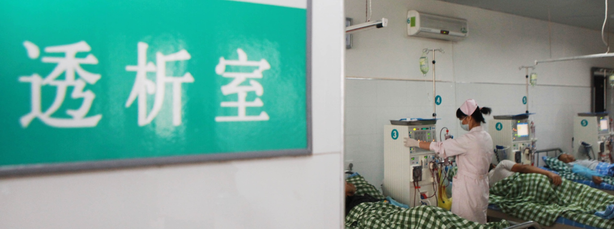
Healthcare
    Five years ago, the Ministry of Health and the National Population and Family Planning Commission were merged to create the National Health and Family Planning Commission (“NHFPC”). The stated goal at the time was to optimize the allocation of resources to medical care, public health and family planning services and improve the health of the nation. At the same time, management of the one-child policy was elevated to the National Development and Reform Commission.
    Reform of the healthcare system remains paramount. It hasn’t been fit for purpose for a long time—some may question if it has ever been. The government’s objective is straightforward and ambitious: improve access and affordability to quality medical care.
    The NHFPC and the Office of the Leading Group Overseeing Medical and Healthcare Reform will be disbanded and folded into the newly created National Health Commission (国家卫生健康委员会).
    The new Commission will be responsible for formulating national health policies, coordinating and pushing forward healthcare reform, establishing a national basic medicine system, supervising and administering public health, medical care and health emergencies, and family planning. The Commission will also be responsible for policies to support an aging society and policies to support tobacco control (which was formerly under the Ministry of Industry and Information Technology, which had a conflict of interest with its responsibility for supporting the development of the tobacco industry).
    Registration and approval for drugs and medical devices will be consolidated in a new drug administration that will be established and managed under the newly formed National Market Supervision Administration (国家市场监督管理总局), which will absorb the China Food and Drug Administration and related responsibilities from the State Administration for Industry and Commerce and the General Administration of Quality Supervision, Inspection and Quarantine. The CFDA, SAIC, and AQSIQ will cease to exist.
    The new State Drug Administration (国家药品监督管理局) will oversee issues at the central and provincial level. Drug sales and marketing activities will be overseen by local offices under the National Market Supervision Administration.
    Also impacting healthcare, a new agency will be established focused on health insurance that consolidates administration of China’s three national medical insurance plans and has responsibility to develop and implement policies related to health insurance. The newly established State Medical Insurance Administration (国家医疗保障局) will also be responsible for supervising and administering medical care funds, improving the platform for interprovincial medical services and expense settlement, and managing drug and health service pricing—including negotiating inclusion on the National Reimbursement Drug List.
    Implication: Healthcare regulation will become more streamlined under the reduced number of responsible agencies. The restructuring is designed to drive greater healthcare reform, to achieve the Healthy China 2030 objectives, reestablish trust in China’s healthcare sector, and ensure the safe delivery of comprehensive health services across the nation.
    An important objective of the reform agenda is to move from a disease treatment approach to preventative model with an emphasis on lifestyle, health management and chronic disease management.
    The consolidation of drug and medical device registration, approval and oversight under a single agency will address bureaucratic turf wars and, it is hoped, address endemic drug quality problems that have undermined trust. This restructuring will allow the new agency and those previously in the CFDA to focus on the product lifecycle more holistically. At the same time, reforms in the healthcare insurance sector should increase efficiencies and push a payer-oriented approach.
    Expect further reforms and market opening. In his meeting with the media on March 20, Li Keqiang noted that “for medicines, especially anti-cancer therapies that people and patients are in urgent need of, we will significantly lower the import tariff and eventually to zero.”

Slide 9
Market Supervision
    One of the most far reaching new agencies to be created is the National Market Supervision Administration, which will absorb functions from the Administration of Quality Supervision, Inspection and Quarantine (“AQSIQ”), the State Administration for Industry and Commerce (“SAIC”), and the China Food and Drug Administration (“CFDA”). The AQSIQ, SAIC, and CFDA will cease to exist.
    In addition, the new agency will unify enforcement and oversight of the antitrust with the consolidation of related responsibilities that were previously spread across the National Development and Reform Commission (“NDRC”), the Ministry of Commerce, and the SAIC.
    The new market supervision agency will be responsible for business registration issues, quality control, drug approvals, food safety, intellectual property, and antitrust.
    In addition, the new supervisory body will oversee several additional agencies. This includes an expanded State Intellectual Property Office (国家知识产权局) which is intended to strengthen the protection of intellectual property. The new State Intellectual Property Office (“SIPO”) will incorporate intellectual property related responsibilities previously under the State Administration for Industry and Commerce (“SAIC”) and the Administration of Quality Supervision, Inspection and Quarantine (“AQSIQ”). The restructuring aligns the creation, protection and application of intellectual property rights across trademarks, patents and geographical indications that were separated across multiple agencies and subject to overlapping enforcement. Responsibility for copyrights will reportedly remain with the National Copyright Administration.
    And, as noted in the section on healthcare, a newly established State Drug Administration will oversee drug related issues at the central and provincial level. Drug sales and marketing activities will be overseen by local offices under the National Market Supervision Administration.
    Implication: Many of the consolidated responsibilities have been spread across multiple agencies and, as a result, subject to turf wars. The creation of this ‘super’ supervisory agency is an attempt to tackle these conflicts. Yet, the combination of so many functions is unlikely to be simple and may still hamper policy formation and enforcement.
Content
    Five-years ago the nation's broadcast watchdog, the State Administration of Radio, Film and Television (“SARFT”), and the General Administration of Press and Publication (“GAPP”) were merged to create a super content authority with a remit spanning print, radio, and visual media.
    The unpronounceable SAPPRFT (State Administration of Press, Publication, Radio, Film, and Television), which was also responsible for managing the National Copyright Administration, is being disbanded in this latest restructuring.
    The newly formed State Administration of Radio and Television (国家广播电视总局) will be responsible for drafting policies and measures for radio and television management and its implementation, coordinating development of broadcasting, promote reform, supervision, and review mechanisms covering radio, television, internet audio and internet video, and importing radio and television programs.
    The Publicity Department of the Communist Party (中共中央宣传部) will take regulatory responsibility for China’s film sector and press and publication. The function responsible for film will be the National Film Bureau (国家电影局).
    The new film bureau will be responsible for developing and supervising film production, screening, film content review (censorship), international joint production and film import and export.
    In addition, China Central Television, China National Radio and China Radio International are to be consolidated into a new broadcaster. Domestically they will maintain their existing names, but internationally they will be rebranded as Voice of China (中国之声). According to the restructuring plan, the new state broadcaster will be responsible for improving communications to audiences outside China and enhancing how the Party’s messages are pushed domestically and its “ability to shape public opinion.” Voice of China’s international engagement is inspired by Voice of America and Germany’s Deutsche Welle.
    Implication: SAPPRFT was formed five-years ago to streamline clearance (or censorship) of content. The rationale behind separating film from television and the internet is unclear given the synergy in content across television, film and internet channels.
    While titles may change, we do not anticipate any lessoning of content controls in the years ahead as the leaders marshal forward the broader reform agenda. On the contrary, we see this as further strengthening of control over state media.
Immigration
    The newly created State Immigration Administration (国家移民管理局) will be responsible for enhancing how China manages exit and entry services for Chinese nationals and supports China’s desire to attract more skilled foreigners.
    The new immigration authority will combine the Ministry of Public Security's immigration and border inspection duties and absorb the immigration responsibilities that were previously under the Ministry of Foreign Affairs. The new bureau will operate under the Ministry of Public Security.
    The State Administration of Foreign Expert Affairs will not be wrapped into the new immigration authority and instead by folded into the Ministry of Science and Technology.
    Implication: Official data indicate more than 900,000 foreign citizens were working in mainland China in 2016, a number that broke the 1 million mark last year. At the same time, a growing number of Chinese nationals are living overseas—as of 2013, approximately 9.3 million.
    Official statements have focused on the importance of centralizing immigration-related duties and attracting the brightest minds—in many ways an attempt to mimic the success the US has had by attracting talent.
    Yet, if the new immigration authority is influenced by its direct reporting line to the Ministry of Public Security, then expect challenges achieving its full potential in welcoming foreign nationals to China. Time will tell if this really is an opening up to support more foreign workers on the ground in China.

Slide 10
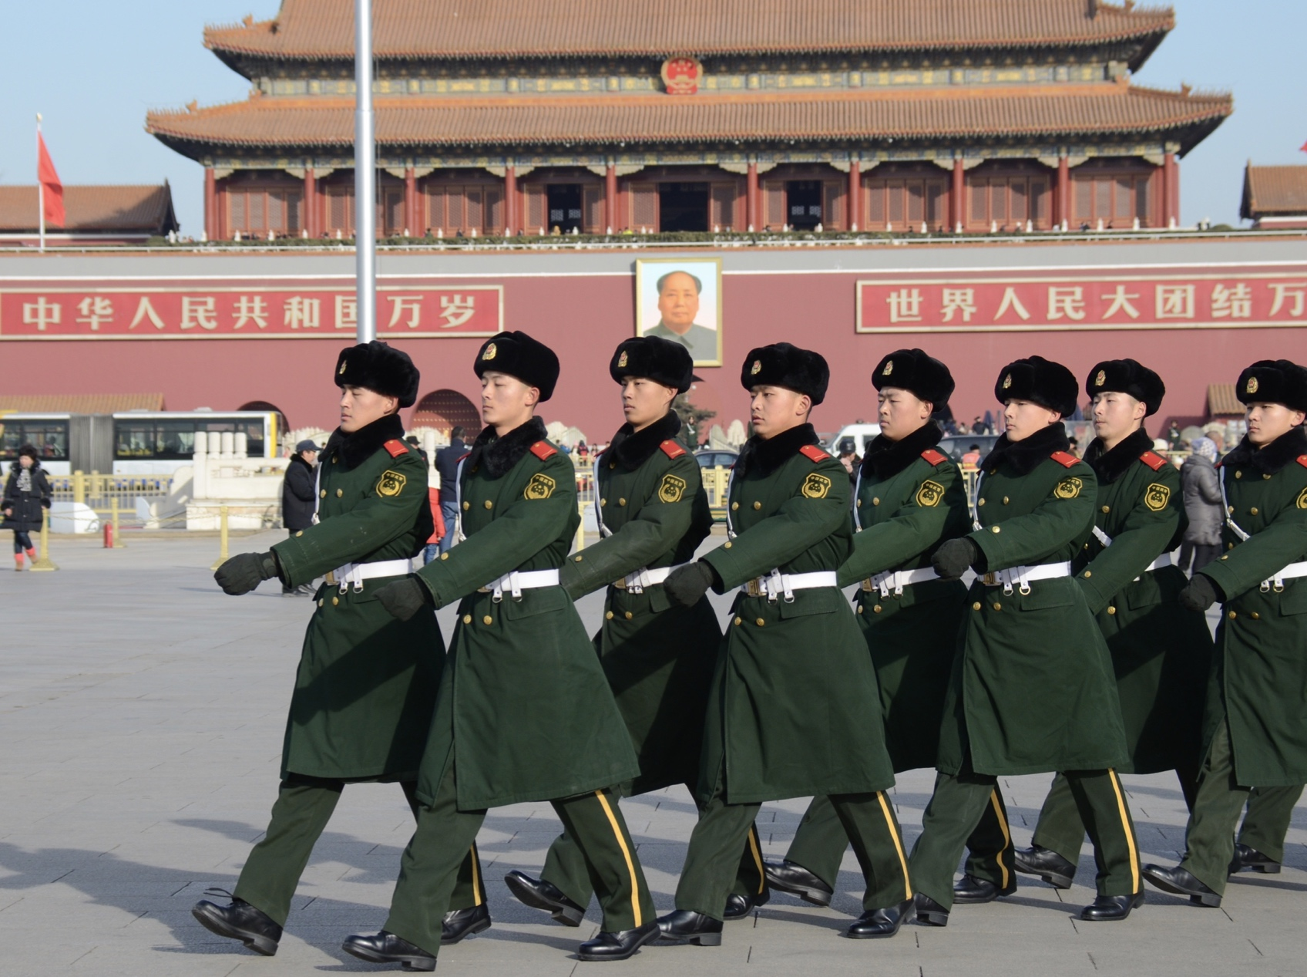
Foreign Aid
    China is setting up a dedicated agency to coordinate its foreign aid policies. The new agency will take roles previously divided between the Ministry of Commerce and the Ministry of Foreign Affairs.
    The State International Development Cooperation Agency (国家国际发展合作署) will be responsible for planning and coordinating major foreign aid issues and foreign aid policies, identifying major aid programs, supervising and evaluating implementation of aid programs, and optimizing China’s methods of offering foreign aid.
    The agency is intended to give full play to the role of foreign aid as a key instrument of China's diplomacy as a major country, the reform plan says.
    Implication: The creation of an international development agency is a means to bring greater coordination across its fragmented foreign aid work and enhance the country’s global engagement and ‘soft power’.
    China has emerged as a key provider of foreign aid to the developing world. Its aid—ranging from food, disaster relief materials, and machinery to schools, houses, and infrastructure projects—can be seen across Asia, Africa, and Latin America.
    Expect more robust engagement via its foreign aid program “as a key instrument of China’s diplomacy as a major country” (as stated in the reform plan). The agency will also have a special focus on supporting the Belt and Road Initiative.
Military Veterans
    The newly announced Ministry of Veteran Affairs (退役军人事务部) will elevate how China treats and honors former military personnel with the consolidation of responsibilities that were spread across the Ministry of Civil Affairs, Ministry of Human Resources and Social Security, and two bodies under the Central Military Commission.
    The new agency will be responsible for creating and implementing policies related to veterans, managing retirement, reemployment and vocational training for veterans, coordinating support for military personnel and their families, maintaining military cemeteries, and hosting commemorative events.
    Implication: China’s active military is one of the world’s largest—even after Xi Jinping announced in 2015 that the number of active military personnel would be reduced by 300,000 to only two million. While China’s leaders extol its commitment to peace, it is at the same time focused on the modernization of the country’s military—including the caliber of military personnel that are suited for future warfare.
    The establishment of a veteran affairs agency to manage more than 57 million veterans is an important part of the evolution of the military. It supports China’s geopolitical ambitions (also captured in the creation of the State International Development Cooperation Agency) by increasing how the military and veterans are treated an honored. Expect more initiatives to drive pride in China’s military and the role it plays in the image of the nation—think more Wolf Warrior 2, which last year became the highest-grossing Chinese film ever released with its patriotic plot which saw a former military officer in an African country protecting medical aid workers from local rebels and arms dealers.

Slide 11
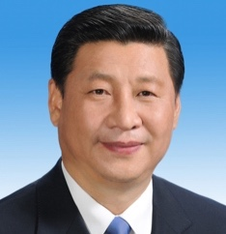
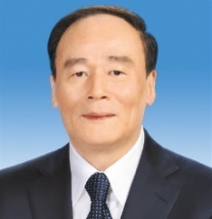
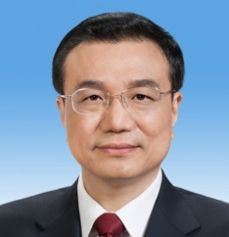
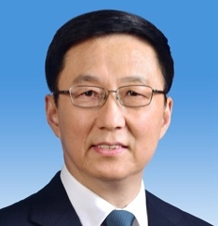
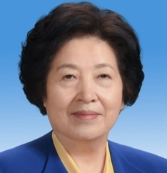
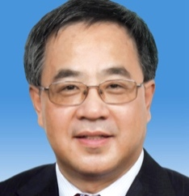
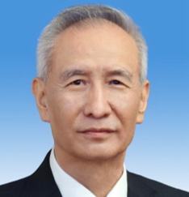
(Some) Change at the Top
    The ten person State Council, China’s highest administrative body, is a now a mix of staunch Xi allies and highly capable figures who will continue to toe the line and push forward Xi’s agenda.
  President & Vice President
  President & Vice President
    Xi Jinping (习近平), 64, China’s most powerful leader since Mao Zedong, was unanimously re-elected for a second five-year term as president. The removal of the two-term limit on the presidency effectively opens the door for him to rule for at least the next decade—or even for life.
    While Xi was born a “princeling” in Beijing, he spent decades working his way up party and government ranks in Fujian, Zhejiang and Shanghai until being promoted into the Politburo Standing Committee in 2007. Xi led the unprecedented anti-corruption campaign to crack down on “tigers and flies” and consolidate his power within the party, military and government during his first five-year term.
    Wang Qishan (王岐山), 69, was (aside from Xi Jinping) the key man in the last administration. A long-term ally and friend of Xi, he led the Party’s anti-corruption drive over the past five years. Wang has been appointed vice president despite stepping down from the Politburo Standing Committee last year as he approached the unofficial retirement age.
    Wang is almost universally seen as one of China’s most competent officials, having earned the moniker “firefighter” for his handling of issues from financial bankruptcy to SARS and, most recently, corruption.
    He is expected to reshape this traditionally ceremonial role into a substantial one, with responsibility for economic and foreign policy matters on top of ongoing anti-corruption efforts. Wang will become a member of the Central Leading Group of Foreign Affairs, with a brief to handle an increasingly bumpy relationship with the Trump Administration.
  State Council:
  Premier & Vice Premiers
    Li Keqiang (李克强), age 62, will serve his second term as premier, having been vice premier from 2008 to 2013 and a Politburo Standing Committee member since 2007. While the premier has historically taken a lead on economic matters, Li was widely felt to have been sidelined during President Xi’s first time. His influence will likely decline further with Liu He, a close Xi ally, in charge of the economy.
    Han Zheng (韩正), age 63, is taking his first role outside Shanghai in a career that has spanned more than 30 years in the city. He oversaw the launch of China’s first free-trade zone in 2012 and the development of Shanghai as a commercial hub. Han joined the Politburo in 2012 and the Standing Committee in 2017.
    Sun Chunlan (孙春兰), 67, is the only woman in the new State Council leadership, as well as the Politburo. Prior to taking the role of vice premier, Sun had been head of the United Front Work Department since 2014. She served in two prominent regional posts, as party secretary of Fujian and then Tianjin.
    Hu Chunhua (胡春华), at 54 the youngest member of the Politburo, becomes one of four vice premiers. Long tipped as a rising star and, until not long ago, a potential successor to Xi Jinping, Hu most recently served as party secretary of Guangdong.
    Liu He (刘鹤), 66, becomes vice premier, having spent years as an economic advisor to the top leadership. A Politburo member since 2017, Liu has served as head of the Leading Group for Financial and Economic Affairs inside the Central Committee of the Communist Party, and the vice chairman of the National Development and Reform Commission.
    Liu’s appointment demonstrates the new government’s determination to fix China’s financial system.
    Widely seen as a reformer in the Chinese context, he will oversee the revamped financial regulatory apparatus and is expected to lead economic policymaking and planning. Mr. Liu led a Chinese delegation to the U.S. last month in an attempt to defuse trade tensions.
Xi Jinping
President
Wang Qishan
Vice President
  The State Council
Li Keqiang
Premier
Han Zheng
Vice Premier
Sun Chunlan
Vice Premier
Hu Chunhua
Vice Premier
Liu He
Vice Premier

Slide 12
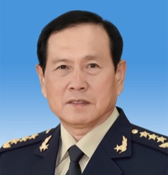
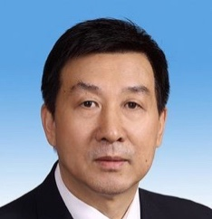
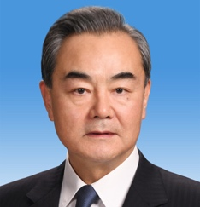
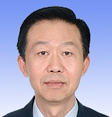
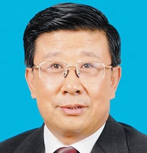
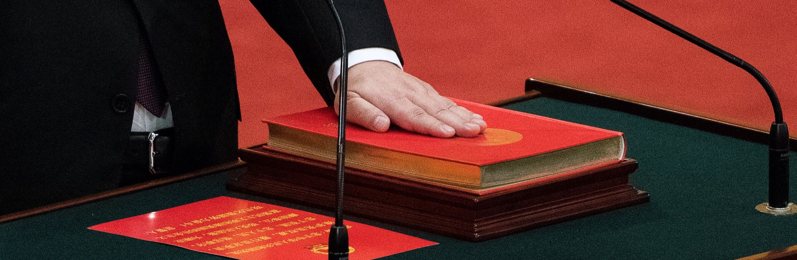
  State Council: State Councillors
    Wei Fenghe (魏凤和), age 64, leads the Ministry of National Defence, and has been a member of the Communist Party Central Military Commission since 2013. He has spent his entire career with the People’s Liberation Army.
    Wang Yong (王勇), age 62, is an accomplished engineer, having had a long career in the former Ministry of Aerospace (now China Aerospace Science and Technology Corporation). He later joined the Central Organization Department and the State-owned Assets Supervision and Administration Commission, and led the State Administration of Quality Supervision, Inspection and Quarantine from 2008 to 2010, before returning to SASAC for a three-year term. He has been in the State Council since 2013.
    Wang Yi (王毅), 64, is a professional diplomat and fluent Japanese speaker, with a long career in the Ministry of Foreign Affairs. Twice posted to Japan as minister counsellor and ambassador respectively, he is also experienced in dealing with Taiwan affairs. Wang is expected to oversee foreign affairs, making him a key figure as the administration becomes increasingly aware of the complexity of China’s relationship with the outside world.
    Xiao Jie (肖捷), age 60, is a well-trained economist, having spent a long career in the Ministry of Finance. He will serve as the secretary general of the State Council, an important coordinating role.
    From 2013 to 2016, he was vice secretary-general of the State Council. He gained regional experience as vice-governor of Hunan from 2005 to 2007, and also headed the State Administration of Taxation from 2007 to 2013.
    Zhao Kezhi (赵克志), 64, has led the Ministry of Public Security since 2017. Before taking a central government role, he served in Hebei, Guizhou, Jiangsu, and Shandong, giving him broad experience of handling regional affairs. Zhao began his career in Shandong province.
Wei Fenghe
State Councillor
Wang Yong
State Councillor
Wang Yi
State Councillor
Xiao Jie
State Councillor
Zhao Kezhi
State Councillor

Slide 13
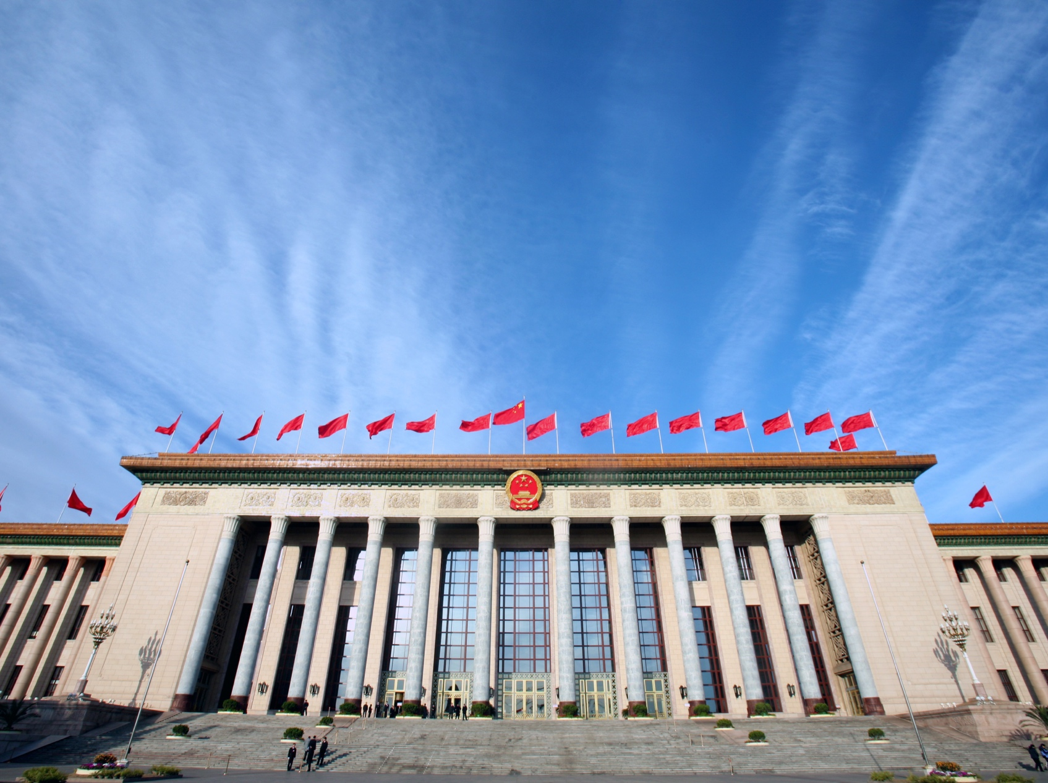
Political Backgrounder
What are the Two Sessions?
    The Two Sessions, or lianghui (两会) as the sessions are commonly known in China, are the annual gathering of the National People’s Congress (全国人民代表大会全国人民代表大会) and the Chinese People’s Political Consultative Conference (中国人民政治协商会议中国人民政治协商会议). The Two Sessions are typically held during the first two weeks in March.
What is the NPC?
    The National People’s Congress (NPC) is the highest legislative body in China and has sole responsibility for enacting legislation in the country. The NPC meets once a year in March and enacts and amends basic laws relating to the Constitution, criminal offences, civil affairs, state organs and other relevant matters. When the NPC is not in session each March, the Standing Committee of the NPC is tasked with enacting and amending laws, with the exception of basic laws that must be enacted by the NPC.
    The NPC is also responsible for electing and appointing members to central state organs—including the Standing Committee of the NPC, the president of the People’s Republic of China (currently Xi Jinping) and the premier of the State Council (currently Li Keqiang). Based on nominations by the premier, the NPC is also respon­sible for appointing China’s vice premiers, state councilors, and ministers.
    This is the first session of the 13th NPC. The 13th NPC was formed in March 2018 and will serve a five year term.
What is the CPPCC?
    The Chinese People’s Political Consultative Conference (CPPCC) is a political advisory body that consists of representatives from a range of political organization, academia, business lead­ers, celebrities, and other experts. The National Committee of the Chinese People’s Political Consultative Conference (中国人民政治协商会议全国委员会会) meets on an annual basis at the same time as the NPC.
    This is the first session of the 13th CPPCC.

Slide 14
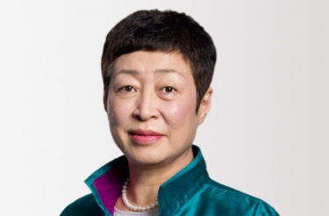
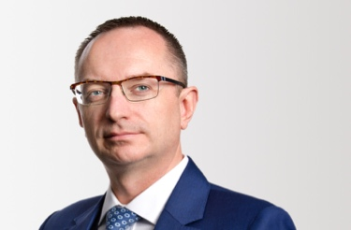
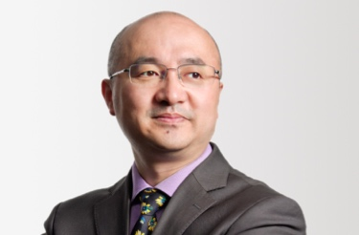
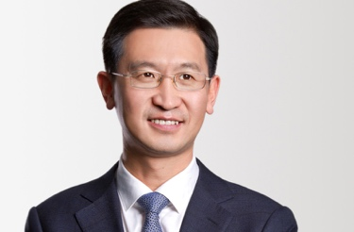
Brunswick Group
Brunswick is an advisory firm specializing in business critical issues. We help companies build trusted relationships with all their stakeholders.
    When clients turn to us, it’s because they know that engaging effectively with everyone who has a stake in the company is about more than managing perceptions - it is essential to making business work.
    Brunswick is one firm globally. Delivering anywhere, we have a reputation for high-caliber, highly experienced people who have diverse backgrounds and skills.
    It means whatever the task, no matter how complex or where it is in the world, we can assemble the right expertise from right across the firm.
    Our purpose is to help the great value creating organizations of the world play a more successful role in society.
    Founded in London in 1987, we established our China presence in 2004 and today have a team of more than 100 based in Beijing, Hong Kong and Shanghai.
The Authors
MEI Yan
Senior Partner and Head of China, Beijing
ymei@brunswickgroup.com
Yan oversees Brunswick’s China business. She joined from Viacom, where she led MTV Networks Greater China and was chief rep of Viacom Asia.
St. John MOORE
Partner and Head of Beijing
smoore@brunswickgroup.com
St. John has advised Chinese and foreign companies on public affairs, issue management, cross-border M&A, and long-term corporate reputation since moving to Beijing in the 1990s.
Gordon GUO
Partner, Beijing
gguo@brunswickgroup.com
Gordon joined following 18 years at the Ministry of Commerce during which he spent four years at the Chinese Embassy in the UK and was separately seconded into multiple Chinese trade associations.
Beijing
2605 Twin Towers (East),
12B Jianguomenwai Avenue,
Beijing, 100022, China
+86 (10) 5960-8600
ZHAO Renfeng
Partner, Beijing
Hong Kong
rzhao@brunswickgroup.com
12 Floor, Dina House,
11 Duddell Street, Central
Hong Kong SAR
Renfeng has over 20 years of experience in journalism and communications, including 10 years in Denmark, Holland and the UK. He specializes in cross-border communications for both Chinese and international clients.
+852 3512-5000
Shanghai
2907 United Plaza,
1468 Nanjing Road West,
Shanghai, 200040, China
The authors wish to also give special thanks to Baijia Liu, Catherine Huang, Helen Zhao, Linjia Dai, Nick Beswick, Rita Fung, and Qi Zhang for their contributions to this report.
+86 (21) 6039-6388

